Slide 1
Smart Parking
Introduction:
Smart parking" refers to a system that uses various technologies to improve the management of parking spaces and make the parking experience more convenient for drivers. These systems can include sensors, cameras, and data analytics to monitor and manage parking spaces in real-time. Here are some key features and benefits of smart parking systems

Slide 2
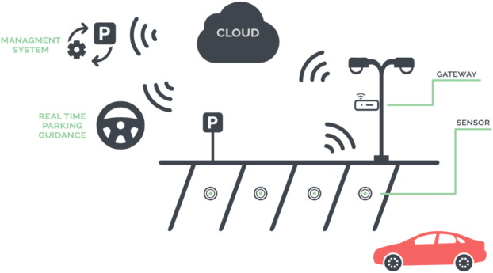
Real-time Availability Information:
Smart parking systems provide real-time information about available parking spaces, helping drivers find a parking spot quickly and efficiently. This information is often made available through mobile apps or electronic signs.

Slide 3
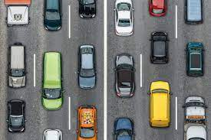
Reduced Traffic Congestion:
By helping drivers find parking spaces more efficiently, smart parking systems can reduce traffic congestion in urban areas. This leads to a decrease in pollution and a more pleasant driving experience.

Slide 4
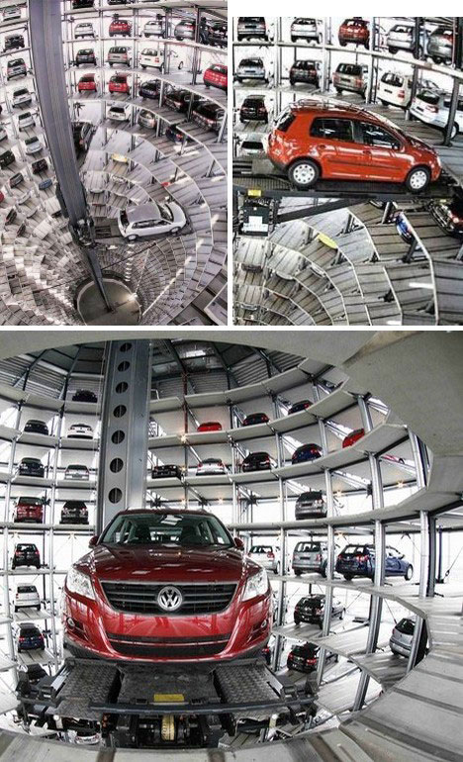
Cost Savings:
Smart parking systems can reduce fuel consumption and the time spent searching for parking, ultimately saving drivers money. This can also lead to a reduction in greenhouse gas emissions.

Slide 5
Automatic parking:
It is often referred to as "automated parking," is a technology-driven system that allows vehicles to be parked with minimal or no human intervention. This advanced parking solution uses various technologies, including robotics, sensors, and automation, to navigate and position a vehicle within a parking space. Automatic parking systems offer several benefits, including increased parking density, reduced search time for parking, and improved convenience for drivers. Here are the key features and components of automatic parking systems:

Slide 6
Vehicle E
Vehicle Entry:
Drivers typically enter an automatic parking facility or structure and leave their vehicle at a designated drop-off area or entrance.
Vehicle Recognition:
The system identifies the vehicle using various methods, such as license plate recognition, RFID, or barcode scanning.
Automated Vehicle Transport:
Once recognized, the vehicle is driven or transported autonomously to an available parking space within the automated parking facility. This process can involve robotic platforms, conveyors, or lift systems.
Precise Positioning:
Automated parking systems are designed to park vehicles with extreme precision, optimizing space usage and minimizing the risk of collisions.

Slide 7

CONCLUSION:
Automatic parking systems are often used in urban areas with high demand for parking, as they make efficient use of limited space. These systems can be found in commercial parking garages, residential complexes, and mixed-use developments. While they offer significant advantages, they also require substantial investment in infrastructure and technology.

